Slide 1
AVRO, Sqoop, Hive, Pig
Ajay J. Singala

Slide 2
AVRO

Slide 3
AVRO
As per Wikipedia:
Avro is a row-oriented remote procedure call and data serialization framework developed within Apache’s Hadoop project. It uses JSON for defining data types and protocols, and serializes data in a compact binary format. Its primary use is in Apache Hadoop, where it can provide both a serialization format for persistent data, and a wire format for communication between Hadoop nodes, and from client programs to the Hadoop services. Avro uses a schema to structure the data that is being encoded. It has two different types of schema languages; one for human editing (Avro IDL) and another which is more machine-readable based on JSON.
Notes:
Basically, Avro is a language-independent data serialization system developed by the father of Hadoop, Doug Cutting.
Before I discuss further Avro, allow me to discuss in brief about data serialization and advantages of it.

Slide 4
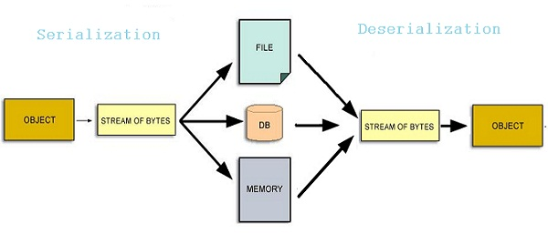
Data Serialization
Data Serialization
The process of converting complex objects (array, dicts, lists, class objects, JSON, etc) into byte streams so that they can be stored or transferred to other machines.
Deserialization
Once the data is received at the other end, it can be reverted back to the original form.
Notes:
What is Data Serialization and DeSerialization?
Data Serialization is the process of converting complex objects(array, dicts, lists, class objects, JSON, etc) into byte streams so that they can be stored or transferred to other machines.
The reason for data serialization of transferring data among computers who have different architecture, hardware, or operating systems.
Once the data is received at the other end, it can be reverted back to the original form.
This process is called Deserialization.
Now you know what is it all about, let’s dig in and play with some code.

Slide 5
AVRO - Installation
Avro: https://avro.apache.org/docs/1.10.0/gettingstartedpython.html
FastAvro: https://github.com/fastavro/fastavro
$pip install avro
Notes:
There are two libraries that are currently being used in Python applications.
One is simply called avro which you can access here. (https://avro.apache.org/docs/1.10.0/gettingstartedpython.html).
And the other is FastAvro (https://github.com/fastavro/fastavro) which claims to be faster than the previous one.
The working of both is the same.
We will use the Avro library.
So, as always use the typical pip tool to install it

Slide 6
AVRO - Schema
Apache Avro format is actually a JSON structure.
It is a combination of a JSON data structure and a schema.
Schema:
.avsc extension
Avro file:
.avro extension.
{"namespace": "me.ajaysingala",
"type": "record",
"name": "User",
"fields": [
{"name": "name", "type": "string"},
{"name": "age", "type": ["int", "null"]},
{"name": "gender", "type": ["string", "null"]}
]
}
Notes:
Apache Avro format is actually a JSON structure.
You can say that Avro format is actually a combination of a JSON data structure and a schema for validation purposes.
So before we create our Avro file which has an extension .avro we will be creating its schema.
The JSON that you see on the right is the Schema, which will name as user.avsc.
Now we will be writing the code that will read the schema from the schema file and then will be adding a few records in the Avro file.
Later, we will be retrieving the records and display them. Let’s write the code!

Slide 7
AVRO – Primitive Data Types
Data type | Description
null | Null is a type having no value.
int | 32-bit signed integer. Maintained as Int32
long | 64-bit signed integer. Maintained as Int64
float | single precision (32-bit) IEEE 754 floating-point number. Maintained as Float
double | double precision (64-bit) IEEE 754 floating-point number. Maintained as Double
bytes | sequence of 8-bit unsigned bytes. Maintained as Blob (use Blob Tool to convert as necessary)
string | Unicode character sequence.
Bool | Boolean. Maintained as Bool

Slide 8
AVRO – Complex Types
Record Type Example:
{
" type ": "record",
" namespace ": "Tutorialspoint",
" name ": "Employee",
" fields ": [
{
"name": " Name",
"type": "string"
},
{
"name": "age",
"type": "int"
}
]
}
Union Type Example:
{
"type" : "record",
"namespace" : "tutorialspoint",
"name" : "empdetails ",
"fields" :
[
{ "name" : "experience", "type": ["int", "null"] },
{ "name" : "age", "type": "int" }
]
}
Array Type Example:
{ " type " : " array ", " items " : " int " }
Enum Type Example:
{
"type" : "enum",
"name" : "Numbers",
"namespace": "data",
"symbols" : [ "ONE", "TWO", "THREE", "FOUR" ]
}
Record
Enum
Arrays
Maps
Unions
Notes:
A record data type in Avro is a collection of multiple attributes.
It supports the following attributes:
name − The value of this field holds the name of the record.
namespace − The value of this field holds the name of the namespace where the object is stored.
type − The value of this attribute holds either the type of the document (record) or the datatype of the field in the schema.
fields − This field holds a JSON array, which have the list of all of the fields in the schema, each having name and the type attributes.
An enumeration is a list of items in a collection.
Avro enumeration supports the following attributes:
name − The value of this field holds the name of the enumeration.
namespace − The value of this field contains the string that qualifies the name of the Enumeration.
symbols − The value of this field holds the enum's symbols as an array of names.
The Array data type defines an array field having a single attribute items.
This items attribute specifies the type of items in the array.
The map data type is an array of key-value pairs, it organizes data as key-value pairs.
The key for an Avro map must be a string.
The values of a map hold the data type of the content of map.
A union datatype is used whenever the field has one or more datatypes. They are represented as JSON arrays.
For example, if a field that could be either an int or null, then the union is represented as ["int", "null"].
Let’s see these in action.

Slide 9
Assignment
Create a MapReduce program in Python using AVRO.

Slide 10
Sqoop

Slide 11
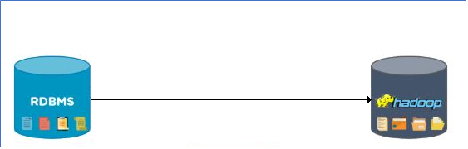
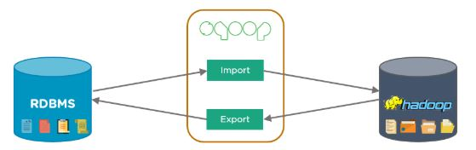
Sqoop
Sqoop
A tool used to transfer bulk data between Hadoop and external datastores, such as relational databases (MS SQL Server, MySQL).
Notes:
Sqoop is a tool used to transfer bulk data between Hadoop and external datastores, such as relational databases (MS SQL Server, MySQL).
To process data using Hadoop, the data first needs to be loaded into Hadoop clusters from several sources.
(click) However, it turned out that the process of loading data from several heterogeneous sources was extremely challenging.
The problems administrators encountered included:
Maintaining data consistency
Ensuring efficient utilization of resources
Loading bulk data to Hadoop was not possible
Loading data using scripts was slow
The solution was Sqoop (click).
Using Sqoop in Hadoop helped to overcome all the challenges of the traditional approach and it could load bulk data from RDBMS to Hadoop with ease.

Slide 12
Sqoop Features
Parallel Import/Export
Sqoop uses the YARN framework to import and export data.
This provides fault tolerance on top of parallelism.
Import Results of an SQL Query
Sqoop enables us to import the results returned from a SQL query into HDFS.
Connectors For All Major RDBMS Databases
Sqoop provides connectors for multiple RDBMSs, such as the MySQL and Microsoft SQL servers.
Kerberos Security Integration
Sqoop supports the Kerberos computer network authentication protocol, which enables nodes communication over an insecure network to authenticate users securely.
Provides Full and Incremental Load
Sqoop can load the entire table or parts of the table with a single command.

Slide 13
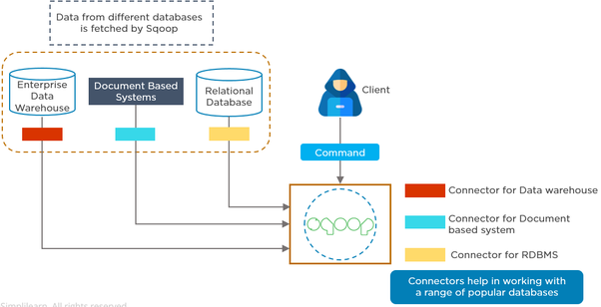

Sqoop Architecture
HDFS / HBase / Hive
Map Task
Notes:
The client submits the import/ export command to import or export data.
Sqoop fetches data from different databases.
Here, we have an enterprise data warehouse, document-based systems, and a relational database.
We have a connector for each of these; connectors help to work with a range of accessible databases.
Multiple mappers perform map tasks to load the data on to HDFS.
Similarly, numerous map tasks will export the data from HDFS on to RDBMS using the Sqoop export command.

Slide 14
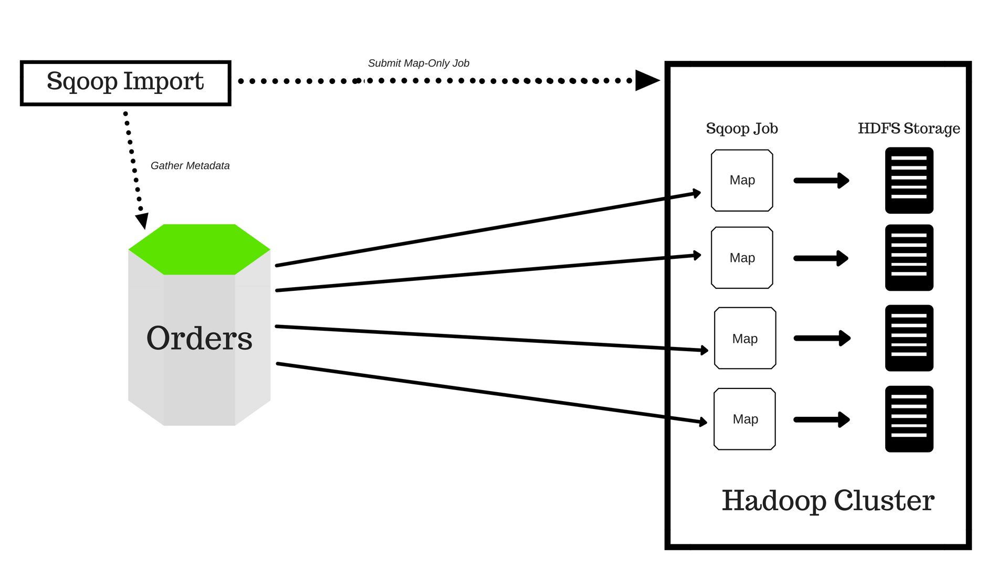
Sqoop Import
Notes:
In this example, a company’s data is present in the RDBMS.
All this metadata is sent to the Sqoop import.
Scoop then performs an introspection of the database to gather metadata (primary key information).
It then submits a map-only job.
Sqoop divides the input dataset into splits and uses individual map tasks to push the splits to HDFS.

Slide 15
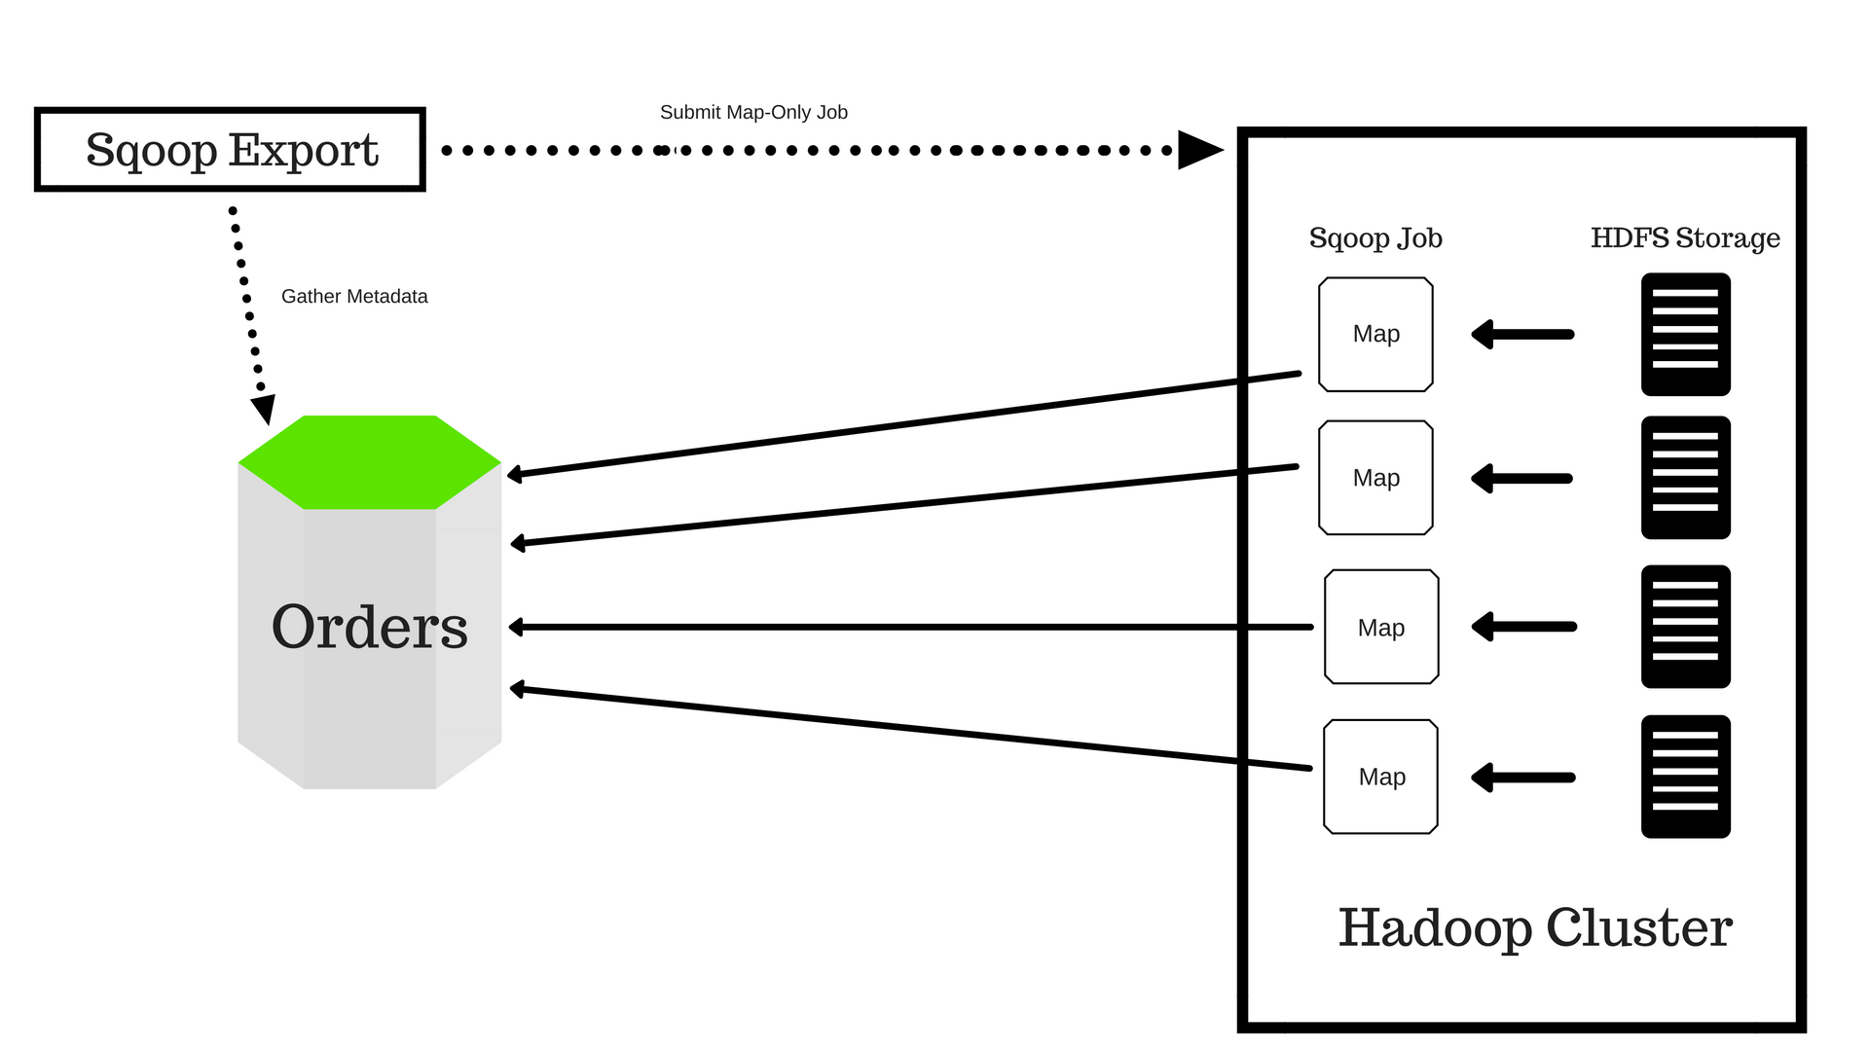
Sqoop Export
Notes:
The first step is to gather the metadata through introspection.
Sqoop then divides the input dataset into splits and uses individual map tasks to push the splits to RDBMS.

Slide 16
Sqoop Processing
Sqoop runs in the Hadoop cluster.
It imports data from the RDBMS or NoSQL database to HDFS.
It uses mappers to slice the incoming data into multiple formats and loads the data in HDFS.
Exports data back into the RDBMS while ensuring that the schema of the data in the database is maintained.
Notes:
Processing takes place step by step, as follows:
Sqoop runs in the Hadoop cluster.
It imports data from the RDBMS or NoSQL database to HDFS.
It uses mappers to slice the incoming data into multiple formats and loads the data in HDFS.
Exports data back into the RDBMS while ensuring that the schema of the data in the database is maintained.

Slide 17
Sqoop - Demo

Slide 18
Hive

Slide 19

Hive
Hive is a distributed data warehouse system developed by Facebook.
Hive is a data warehouse system that is used to query and analyze large datasets stored in the HDFS.
Hive uses a query language called HiveQL (aka HQL), which is similar to SQL.
Notes:
Hive is a distributed data warehouse system developed by Facebook.
Facebook adopted the Hadoop framework to manage their big data.
Hadoop uses MapReduce to process data.
With MapReduce, users were required to write long and extensive Java code.
Not all users were well-versed with Java and other coding languages.
Users were comfortable with writing queries in SQL (Structured Query Language), and they wanted a language similar to SQL.
Enter the HiveQL language.
The idea was to incorporate the concepts of tables and columns, just like SQL.
Hive is a data warehouse system that is used to query and analyze large datasets stored in the HDFS.
Hive uses a query language called HiveQL, which is similar to SQL.
As seen from the image,
The user first sends out the Hive queries.
These queries are converted into MapReduce tasks that accesses the Hadoop MapReduce system.

Slide 20
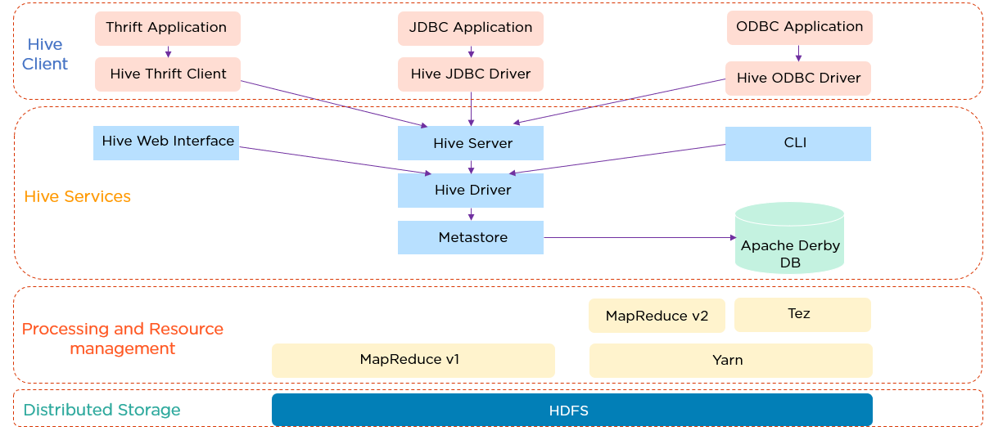
Hive Architecture
Notes:
The Hive client supports different types of client applications in different languages to perform queries.
Thrift is a software framework.
The Hive Server is based on Thrift, so it can serve requests from all of the programming languages that support Thrift.
Next, we have the JDBC (Java Database Connectivity) application and Hive JDBC Driver.
The JDBC application is connected through the JDBC Driver.
Then we have an ODBC (Open Database Connectivity) application connected through the ODBC Driver.
All these client requests are submitted to the Hive server.
Then there are the Hive Services that has the Hive web interface, or GUI, where programmers execute Hive queries.
Commands can also be executed directly in CLI.
Up next is the Hive driver, which is responsible for all the queries submitted.
It performs three steps internally:
Compiler - The Hive driver passes the query to the compiler, where it is checked and analyzed
Optimizer - Optimized logical plan in the form of a graph of MapReduce and HDFS tasks is obtained
Executor - In the final step, the tasks are executed
Metastore is a repository for Hive metadata.
It stores metadata for Hive tables, and you can think of this as your schema.
This is located on the Apache Derby DB.
Hive uses the MapReduce framework to process queries.
Finally, we have distributed storage, which is HDFS.
Let’s see how does the data flow in the Hive.

Slide 21
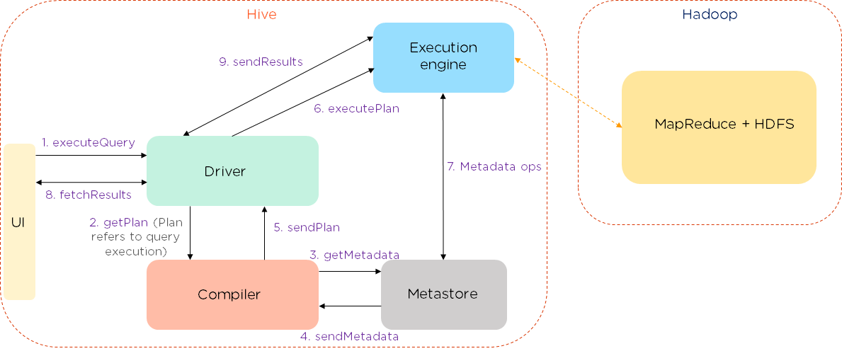
Hive Data Flow
Notes:
The data flows in the following sequence:
We execute a query, which goes into the driver.
Then the driver asks for the plan, which refers to the query execution.
After this, the compiler gets the metadata from the metastore.
The metastore responds with the metadata.
The compiler gathers this information and sends the plan back to the driver.
Now, the driver sends the execution plan to the execution engine.
The execution engine acts as a bridge between the Hive and Hadoop to process the query. In addition to this, the execution engine also communicates bidirectionally with the metastore to perform various operations, such as create and drop tables.
Finally, we have a bidirectional communication to fetch and send results back to the client.
Now take a look at Hive data modeling, which consists of tables, partitions, and buckets.

Slide 22
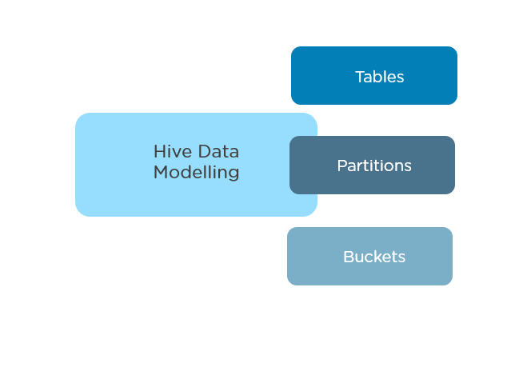
Hive Data Modeling
Tables
Partitions
Buckets
Notes:
Hive data modelling consists of tables, partitions, and buckets:
Tables - Tables in Hive are created the same way it is done in RDBMS.
Partitions - Here, tables are organized into partitions for grouping similar types of data based on the partition key.
Buckets - Data present in partitions can be further divided into buckets for efficient querying.
Let us dive into the Hive data types.

Slide 23
Hive Data Types
Primitive Data Types:
Numeric - Data types like integral, float, decimal
String - Data types like char, string
Date/Time - Data types like timestamp, date, interval
Miscellaneous - Data types like Boolean and binary
Complex Data Types:
Arrays - A collection of the same entities.
Syntax: array<data_type>
Maps - A collection of key-value pairs.
Syntax: map<primitive_type, data_type>
Structs - A collection of complex data with comments.
Syntax: struct<col_name : data_type [COMMENT col_comment],…..>
Units - A collection of heterogeneous data types.
Syntax: uniontype<data_type, data_type,..>

Slide 24
Hive Modes
Hive operates in two modes depending on the number and size of data nodes:
Local Mode
MapReduce Mode
Notes:
Hive operates in two modes depending on the number and size of data nodes. They are:
Local Mode
Used when Hadoop has one data node, and the amount of data is small.
Here, the processing will be very fast on smaller datasets, which are present in local machines.
MapReduce Mode
Used when the data in Hadoop is spread across multiple data nodes.
Processing large datasets can be more efficient using this mode.

Slide 25
Hive vs RDBMS
Hive | RDBMS
Hive enforces schema on reading | RDBMS enforces schema on write
Hive data size is in petabytes | Data size is in terabytes
Hive is based on the notion of write once and read many times | RDBMS is based on the notion of reading and write many times
Hive resembles a traditional database by supporting SQL, but it is not a database; it is a data warehouse | RDBMS is a type of database management system, which is based on the relational model of data
Easily scalable at low cost | Not scalable at low cost

Slide 26
Hive Features
The use of a SQL-like language called HiveQL in Hive is easier than long codes.
In Hive, tables are used that are similar to RDBMS, hence easier to understand.
By using HiveQL, multiple users can simultaneously query data.
Hive supports a variety of data formats.

Slide 27
Hive Demo

Slide 28
Pig

Slide 29
Pig
Oink-oink! Grunt-grunt!
Scripting platform on Hadoop
Process and analyze large datasets
Extensible
Self-optimizing
Easily programmed
Notes:
Pig is a scripting platform that runs on Hadoop clusters designed to process and analyze large datasets.
Pig is extensible, self-optimizing, and easily programmed.
Programmers can use Pig to write data transformations without knowing Java.
Pig uses both structured and unstructured data as input to perform analytics and uses HDFS to store the results.

Slide 30
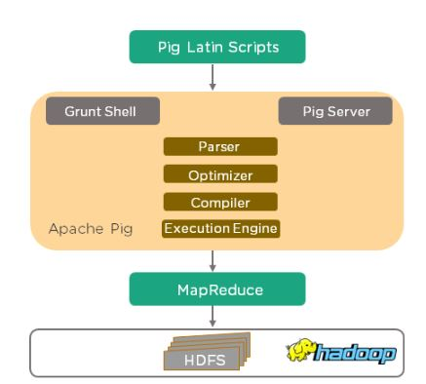
Pig Components
Pig Latin script language
A runtime engine (compiler)
Notes:
Pig Latin script language
The Pig Latin script is a procedural data flow language.
It contains syntax and commands that can be applied to implement business logic.
Examples of Pig Latin are LOAD and STORE.
A runtime engine (compiler)
The runtime engine is a compiler that produces sequences of MapReduce programs.
It uses HDFS to store and retrieve data. It is also used to interact with the Hadoop system (HDFS and MapReduce).
The runtime engine parses, validates, and compiles the script operations into a sequence of MapReduce jobs.

Slide 31
Pig Features
Features
Ease of programming
Optimization opportunities
Extensibility
Flexible
In-built operators
Notes:
Features of Apache Pig
Ease of programming
Writing complex java programs for map reduce is quite tough for non-programmers. Pig makes this process easy. In the Pig, the queries are converted to MapReduce internally.
Optimization opportunities
It is how tasks are encoded permits the system to optimize their execution automatically, allowing the user to focus on semantics rather than efficiency.
Extensibility
A user-defined function is written in which the user can write their logic to execute over the data set.
Flexible
It can easily handle structured as well as unstructured data.
In-built operators
It contains various type of operators such as sort, filter and joins.

Slide 32
Pig Modes
Pig executes in two modes:
Local Mode
$ pig -x local
MapReduce Mode
$ pig
$ pig –x mapreduce
Ways to execute a Pig Program:
Interactive Mode
Batch Mode
Embedded Mode
Notes:
Local Mode
It executes in a single JVM and is used for development experimenting and prototyping.
Here, files are installed and run using localhost.
The local mode works on a local file system. The input and output data stored in the local file system.
The command for local mode grunt shell:
$ pig-x local
MapReduce Mode
The MapReduce mode is also known as Hadoop Mode.
It is the default mode.
In this, Pig renders Pig Latin into MapReduce jobs and executes them on the cluster.
It can be executed against semi-distributed or fully distributed Hadoop installation.
Here, the input and output data are present on HDFS.
The command for Map reduce mode:
$ pig
Or,
$ pig -x mapreduce
Ways to execute Pig Program
These are the following ways of executing a Pig program on local and MapReduce mode: -
Interactive Mode - In this mode, the Pig is executed in the Grunt shell.
Interactive mode means coding and executing the script, line by line (like REPL).
To invoke Grunt shell, run the pig command.
Once the Grunt mode executes, we can provide Pig Latin statements and command interactively at the command line.
Batch Mode - In this mode, we can run a script file having a .pig extension.
In Batch mode, all scripts are coded in a file with the extension .pig and the file is directly executed.
These files contain Pig Latin commands.
Embedded Mode - In this mode, we can define our own functions.
These functions can be called as UDF (User Defined Functions).
Here, we use programming languages like Java and Python.

Slide 33
Pig vs MapReduce
Apache MapReduce | Apache PIG
It is a low-level data processing tool. | It is a high-level data flow tool.
Here, it is required to develop complex programs using Java or Python. | It is not required to develop complex programs.
It is difficult to perform data operations in MapReduce. | It provides built-in operators to perform data operations like union, sorting and ordering.
It doesn't allow nested data types. | It provides nested data types like tuple, bag, and map.
Notes:
Advantages of Apache Pig
Less code - The Pig consumes less line of code to perform any operation.
Reusability - The Pig code is flexible enough to reuse again.
Nested data types - The Pig provides a useful concept of nested data types like tuple, bag, and map.

Slide 34
Pig vs SQL
Difference | Pig | SQL
Definition | Pig is a scripting language used to interact with HDFS. | SQL is a query language used to interact with databases residing in the database engine.
Query Style | Pig offers a step-by-step execution style. | SQL offers the single block execution style.
Evaluation | Pig does a lazy evaluation, which means that data is processed only when the STORE or DUMP command is encountered. | SQL offers immediate evaluation of a query.
Pipeline Splits | Pipeline Splits are supported in Pig. | In SQL, you need to run the “join” command twice for the result to be materialized as an intermediate result.

Slide 35
Pig Latin Concepts
Pig Latin Statements:
Can span multiple lines.
Each statement must end with a semi-colon.
It may include expression and schemas.
By default, these statements are processed using multi-query execution
Convention | Description
( ) | The parenthesis can enclose one or more items. It can also be used to indicate the tuple data type. Example - (10, xyz, (3,6,9))
[ ] | The straight brackets can enclose one or more items. It can also be used to indicate the map data type. Example - [INNER | OUTER]
{ } | The curly brackets enclose two or more items. It can also be used to indicate the bag data type Example - { block | nested_block }
... | The horizontal ellipsis points indicate that you can repeat a portion of the code. Example - cat path [path ...]
Pig Latin Conventions:
Notes:
Pig Latin
The Pig Latin is a data flow language used by Apache Pig to analyze the data in Hadoop.
It is a textual language that abstracts the programming from the Java MapReduce idiom into a notation.
Pig Latin Statements
The Pig Latin statements are used to process the data.
It is an operator that accepts a relation as an input and generates another relation as an output.
It can span multiple lines.
Each statement must end with a semi-colon.
It may include expression and schemas.
By default, these statements are processed using multi-query execution

Slide 36
Pig Latin Data Types
Type | Description
int | It defines the signed 32-bit integer.
long | It defines the signed 64-bit integer.
Float | It defines 32-bit floating point number.
double | It defines 64-bit floating point number.
chararray | It defines character array in Unicode UTF-8 format.
bytearray | It defines the byte array.
boolean | It defines the boolean type values.
datetime | It defines the values in datetime order.
Biginteger | It defines Java BigInteger values. Example - 5000000000000
Bigdecimal | It defines Java BigDecimal values. Example - 52.232344535345
Type | Description
tuple | It defines an ordered set of fields. Example - (15,12)
bag | It defines a collection of tuples. Example - {(15,12), (12,15)}
map | It defines a set of key-value pairs. Example - [open#apache]
Values for all these data types can be NULL.
Apache Pig treats NULL values in a similar way as SQL.
Notes:
The table on the left has the simple data types in Pig.
The one on the right has the complex data types in Pig.

Slide 37
Pig - Operators
+, -, *, /, %
?: (BinCond [Binary Condition)]
CASE WHEN THEN ELSE END
Comparison operators (==, !=, >, >=, <, <=, matches)
Matches => Pattern matching
Relational Operators
LOAD – load data from a file system (local/hdfs) into a relation.
STORE – save a relation to the file system (local/hdfs).
Filtering
FILTER, DISTINCT, FOREACH, GENERATE, STREAM
Grouping and Joining
JOIN
COGROUP
GROUP
CROSS

Slide 38
Pig - Operators
Sorting
ORDER, LIMIT
Combining and Splitting
UNION, SPLIT
Diagnostic operators
DUMP
DESCRIBE
EXPLAIN
ILLUSTRATE

Slide 39
Pig Demo

